Slide 1

Machine Learning on streaming data
The Learning Machines
04/13/2018
Notes:
This template is in wide-screen format and demonstrates how transitions, animations, and multimedia choreography can be used to enrich a presentation.

Slide 2
The Learning machines
The child machine could either be one that is as simple as possible, merely maintaining consistency with general principles, or the machine could be one with a complete system of logical inference programmed into it.
Alan turing
Notes:
This slide can be used as a background before the presentation begins.

Slide 3
Real Time Data – Real Challenges
Applying Machine Learning algorithms to real-time data is challenging.
The real-time streaming data may originate from transactional systems, Twitter feeds, news sources, or blogs.
Processing such data is in real-time and applying ML algorithm is challenging.

Slide 4
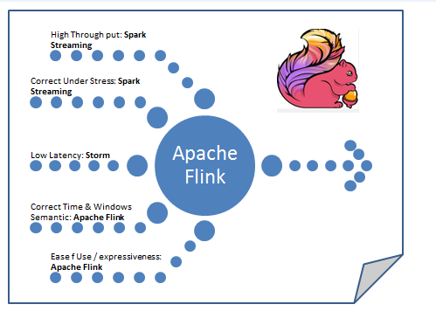
Our solution
Kafka
Apache Flink Machine Learning Algorithms
Real-time dashboards

Slide 5



High Level Process Flow
Summit
Flink Consumer
Flink ML
DB

